Slide 1

StudyConcierge – Intelligent Multi-Agent Study Assistant
A Multi-Agent Autonomous System for Efficient and Personalized Learning
Presented by
ASWIN S

Slide 2

The Challenge: Inefficient Study Workflows
Students often spend excessive time on manual study tasks such as:
Searching for relevant information across various sources.
Reading and synthesizing large volumes of content.
Manually summarizing key concepts.
Organizing and categorizing study materials.
These traditional workflows are not only inefficient but also lead to inconsistent learning outcomes and increased cognitive load.

Slide 3

Project Objective: Automating Personalized Learning
Our goal is to build an AI-driven multi-agent assistant that transforms the study process.
Automated Retrieval
Intelligent Summarization
Effortlessly find and collect study materials.
Condense complex information into digestible insights.
Dynamic Quiz Generation
Personalized Recommendations
Create custom quizzes for effective self-assessment.
Tailor content and learning paths to individual needs.

Slide 4
Introducing StudyConcierge: A Multi-Agent System
StudyConcierge is an autonomous multi-agent system designed for efficient and personalized learning.
Coordinator Agent
Search Agent
Summarizer Agent
Manages overall workflow and task delegation.
Finds relevant information across various sources.
Extracts key information and creates concise summaries.
Quiz Generator Agent
Memory Agent
Develops targeted questions based on learned material.
Stores and retrieves long-term learning history and preferences.

Slide 5
Core Capabilities & Technologies
StudyConcierge leverages advanced AI and engineering principles.
Multi-Agent Orchestration
Tool Use
Sessions & Long-Term Memory
Seamless coordination between specialized agents.
Integration with Search APIs, PDF Readers, and MCP Tools for diverse data handling.
Persistent storage of learning interactions and user profiles.
Retrieval Layer
Autonomous Question Generation
Advanced techniques like Chunking, Embeddings, and Vector Databases for efficient information access.
AI-driven creation of quizzes and prompts for active recall.

Slide 6

Architectural Blueprint
A layered system ensuring robustness and scalability.
Agent & Infrastructure
Search, Summarizer, Quiz, Memory; Tool Bus, APIs, Retrieval, Observability
Coordinator Agent
Orchestrates agent workflows
Core Frontend
User interface and experience
This modular design allows for clear separation of concerns and facilitates future enhancements.

Slide 7
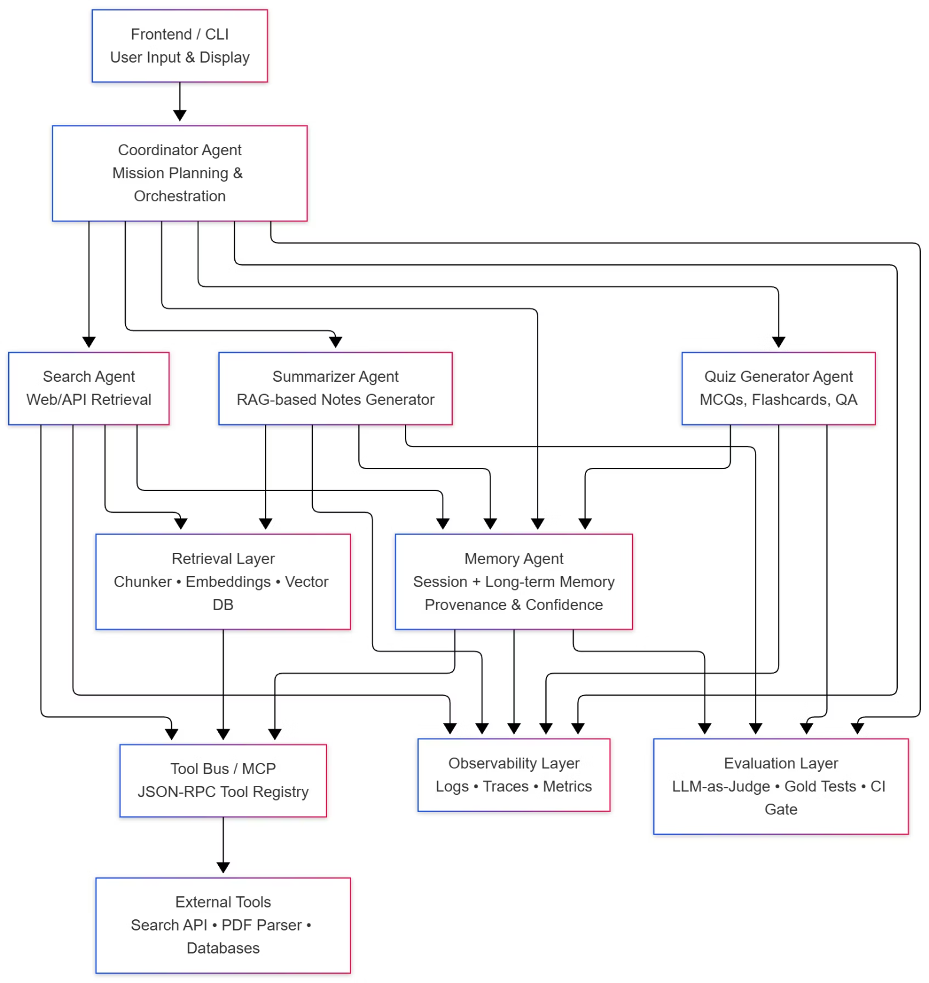
Architecture

Slide 8

StudyConcierge Workflow in Action
A seamless process from user input to personalized output.
User Input
Search
Summarize
Generate Quiz
Each step in the workflow is orchestrated by specialized agents to ensure optimal efficiency and accuracy.

Slide 9

Tools & Interoperability with MCP
Leveraging the Multi-Agent Communication Protocol (MCP) for secure and modular tool interaction.
JSON-RPC MCP Tools: Standardized communication for seamless agent interaction.
Specialized Tools:
Search Tool: Access to web search engines for real-time information.
PDF Tool: Ability to parse and extract information from PDF documents.
Memory Tool: Interface with the long-term memory system.
This architecture ensures safe tool governance and enables modular scaling and interoperability for a dynamic learning environment.

Slide 10
Ensuring Quality, Evaluation, & Observability
Rigorous processes are in place to monitor and enhance system performance.
Agent Tracing
Logs & Metrics
Detailed logging of each agent's turn for transparent operation and debugging.
Monitoring latency, tool call success rates, and other critical system parameters.
LLM-as-Judge Evaluation
CI Gating
Utilizing Large Language Models to autonomously assess the quality and relevance of agent outputs.
Continuous Integration processes to maintain high standards for quality, safety, and reliability.

Slide 11

Conclusion & Future Impact
StudyConcierge revolutionizes the learning experience by:
Automating Study Workflows: Significantly reducing manual effort and time.
Improving Consistency: Delivering high-quality, standardized learning materials.
Personalized Learning: Adapting to individual needs through robust memory functions.
Production-Ready Design: Demonstrating a scalable and robust multi-agent architecture.
This project showcases the potential of intelligent multi-agent systems in modern education.

